Slide 1
Effect of model capacity on data maps
Group - 1
Atharva Naik, Altaf Ahmad, Varun Gupta
18CS10067, 18MA20005, 18MA20050
Notes:
Hello Everyone,We are group 1, In this project, we worked on a model-based tool to characterize and diagnose datasets, that is data maps. Specifically, we experimented with the size of the model and other parameters on the data maps.

Slide 2
Dataset Cartography
Partition/Categorize samples in dataset 𝓓
Finetune a model 𝓜 on 𝓓 and log logits 𝓛 : i→[0,1] across epochs 1 to N (Training Dynamics)
Consider sample 𝓧, y ϵ 𝓓 ,
𝓧 : input features, y : label
𝓛(y): probability of true class/confidence
mean confidence: ĉ = Σ^{N}_{i=1}𝓛(y)/N
variability: σ = Σ^{N}_{i=1}(𝓛(y)-ĉ)²/N
Partition 𝓓 based on ĉ and σ
ambiguous: high σ
easy-to-learn: high ĉ, low σ
hard-to-learn: low ĉ, low σ
Notes:
We begin by giving a quick recap of dataset cartography. It is a technique that can be used to categorize and filter instances in a dataset. To create the data map for a dataset, we finetune a pre-trained language model on it and log the logits for each epoch of training (also called the training dynamics). Then we can derive the mean confidence and variability for each sample in the dataset. Finally we categorize each sample as ambiguous, easy-to-learn or hard-to-learn on the basis of the confidence and variability as shown.

Slide 3
Proposed Experiments
What if we reduce learnable parameters in 𝓜?
Motivation:
Efficient computation of data maps: if 𝓜 has lesser parameters →𝓜 can be fine-tuned faster
How do data maps change when learnable parameters are reduced?
Possible experiments
Replace 𝓜 with 𝓜 ’ such that 𝓜 ’ has similar architecture but lesser parameters
Introduce additional parameters Φ and freeze 𝓜 (Adapters)
Notes:
Since dataset cartography uses training dynamics which is dependant on the model used for finetuning, we investigate the impact of altering the model 𝓜 on the resultant data map. Specifically we explore reducing the number of learnable parameters, to see if dataset cartography can be made more efficient. We also propose quantitative metrics to evaluate changes in data maps

Slide 4

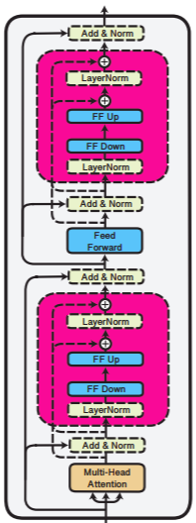
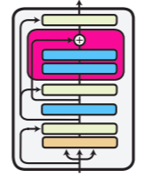
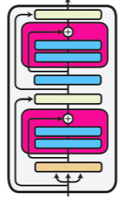
About Adapters
Adapters eliminate need for fine-tuning in pre-trained transformers
additional weights between each transformer layer
only new weights trained, rest frozen
Faster training and performance comparable to SOTA
There are two major adapter architectures: Houlsby and Pfeiffer
We use the default Pfeiffer configuration
Pfeiffer configuration
Houlsby configuration
Notes:
Adapters serve the same purpose as fine-tuning but do it by stitching in layers to the main pre-trained model, and updating the weights Φ of these new layers, whilst freezing the weights θ of the pre-trained model.In contrast, in fine-tuning, we update the pre-trained weights as well, therefore this makes adapters much more efficient, both in terms of time and storage, compared to fine-tuning. Adapters have also been shown to be able to match the performance of state-of-the-art fine-tuning methods, of the two major adapter architectures: Houlsby and Pfeiffer, and we use the default Pfeiffer Configuration

Slide 5
Experimental Design
Dataset: MNLI task, GLUE benchmark
Models:
roberta base: 124.65M
roberta large: 355.36M
roberta base + adapter + classif. head: 124.65M (frozen) + 894.53k + 592.9K
roberta large + adapter + classif. head: 355.36M (frozen) + 3.17M + 1.05M
Comparisons:
Effect of decreasing parameters: roberta-base vs roberta-large
Effect of adapters when param. count is low: roberta-base vs roberta-base with adapter
Effect of adapters when param. count is high: roberta-large vs roberta-large with adapter
Notes:
The paper originally used roberta-large as the model 𝓜. We try using the roberta base model as well as adding a task adapter to roberta large and roberta base. Parameter counts for each model are also reported.

Slide 6
Validation set performance
Best validation accuracy, and corresponding epoch
Same hyper-parameters across each experiment
Experiment | Validation Accuracy | Best Epoch No.
roberta base | 87.7% | 2
roberta large | 89.9% | 3
roberta base with adapter | 86.31% | 18
roberta large with adapter | 90.63% | 6
Notes:
As expected the final validation accuracy reached by the larger models is significantly more than the base models. We also observe that introducing adapters doesn’t necessarily decrease final accuracy, however more epochs are needed to reach best performance.

Slide 7
Evaluation: Partitioning
We partition train-set samples into 3 classes, according to filtering criteria described in the paper:
Ambiguous (A): top 33% by variability
Easy-to-learn (E): top 50% by confidence, among remaining samples
Hard-to-learn (H): bottom 50% by confidence, among remaining samples
Data Partitions | Ambiguous |  | Easy-to-learn |  | Hard-to-learn
 | confidence | variability | confidence | variability | confidence | variability
roberta-base | _ | >0.115 | >0.976 | <0.115 | <0.976 | <0.115
roberta-large | _ | >0.07 | >0.99 | <0.07 | <0.99 | <0.07
roberta-base adapter | _ | >0.13 | >0.934 | <0.13 | <0.934 | <0.13
roberta-large adapter | _ | >0.106 | >0.97 | <0.106 | <0.97 | <0.106
Notes:
To partition the samples first we separate out the top 33% of the samples when ordered by variability.
Next we use the median confidence to separate remaining samples into hard-to-learn and easy-to-learn.
We observe that the adapter variants have higher variability as compared to their non adapter counterparts and that the confidence increases when there are more learnable parameters.

Slide 8
Evaluation: Metrics
To compare models 𝓜₁ and 𝓜₂ we compare class assigned (A,E or H) per instance
We use IR inspired metrics:
Dice coefficient (F1-Score): 2|A∩B|/(|A|+|B|)
Jaccard coefficient (IoU): |A∩B|/|AUB|
Accuracy: no. of instances assigned same class/total no. of instances

Slide 9
Results
jaccard score per class | Jacc A | Jacc E | Jacc H | Avg. Jacc | Acc.
base vs large | 0.516 | 0.545 | 0.341 | 0.467 | 63.15
base vs base w adapter | 0.44 | 0.654 | 0.341 | 0.478 | 63.41
large vs large w adapter | 0.488 | 0.616 | 0.355 | 0.486 | 63.85
dice score per class | Dice A | Dice E | Dice H | Avg. Dice Coeff.
base vs large | 0.681 | 0.705 | 0.509 | 0.632
base vs base w adapter | 0.611 | 0.791 | 0.508 | 0.637
large vs large w adapter | 0.656 | 0.762 | 0.524 | 0.647
Notes:
Firstly we observe that the agreement on which examples are easy to learn in high for each experiment, but there is low agreement for hard-to-learn examples.
We can also see that the highest overlap between the models is when we add adapter to an already large model like roberta-large. However the differences in overlap aren’t that high. We also observe that the overall overlap doesn’t exceed 65% accuracy in any of the experiments. This raises some concerns about stability of data maps.

Slide 10
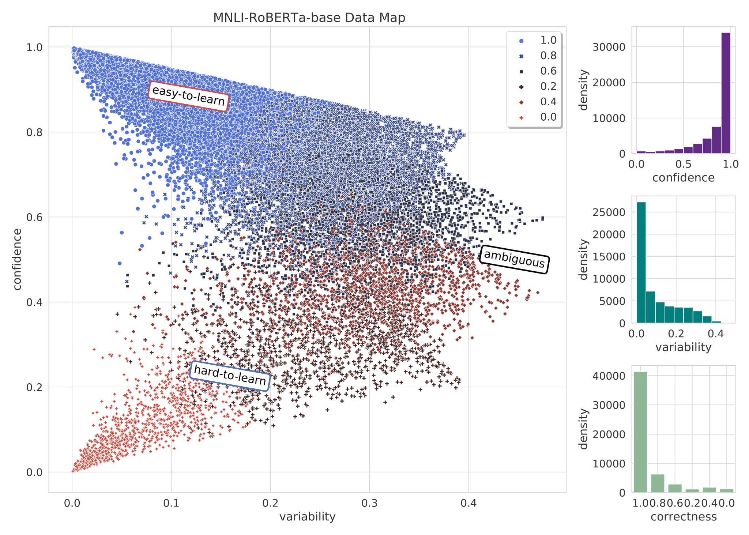
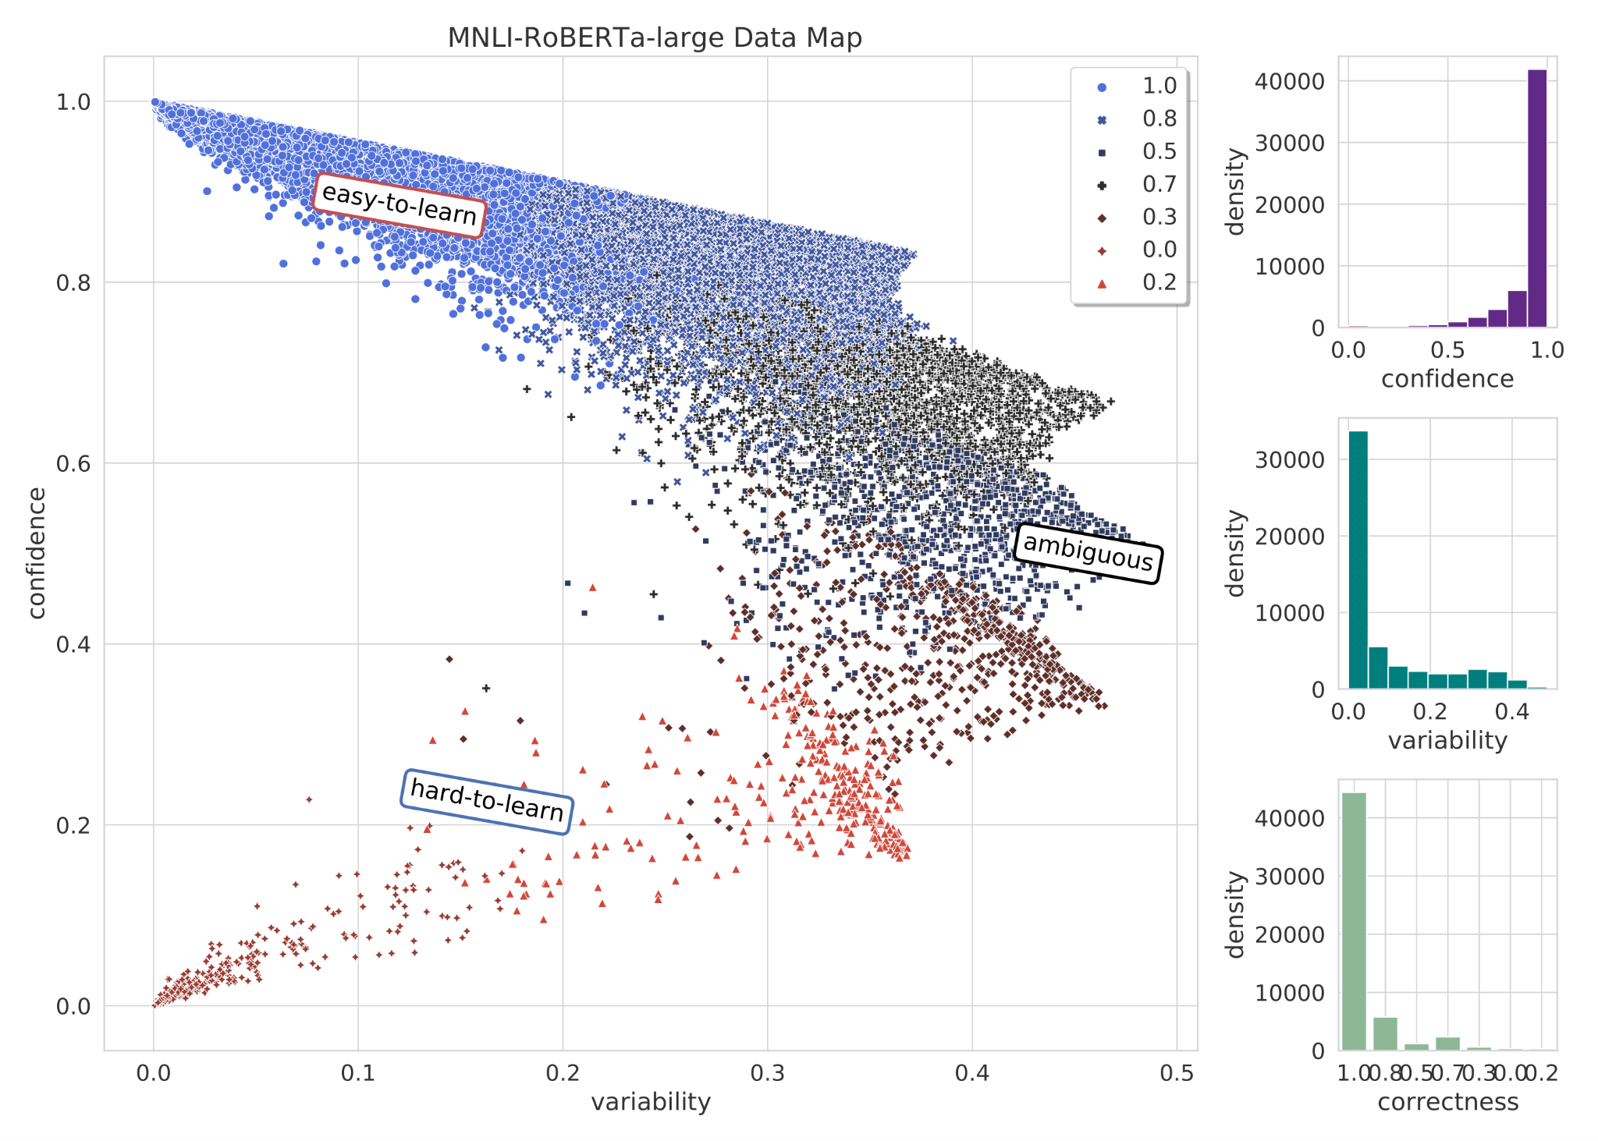
Data Map: roberta-base vs roberta-large
roberta base
roberta large
Notes:
The comparison between the base and large models shows that the examples are skewed towards the easy to learn zone for the larger capacity model and the data map has more mass towards top of the y axis, indicating higher overall confidence

Slide 11
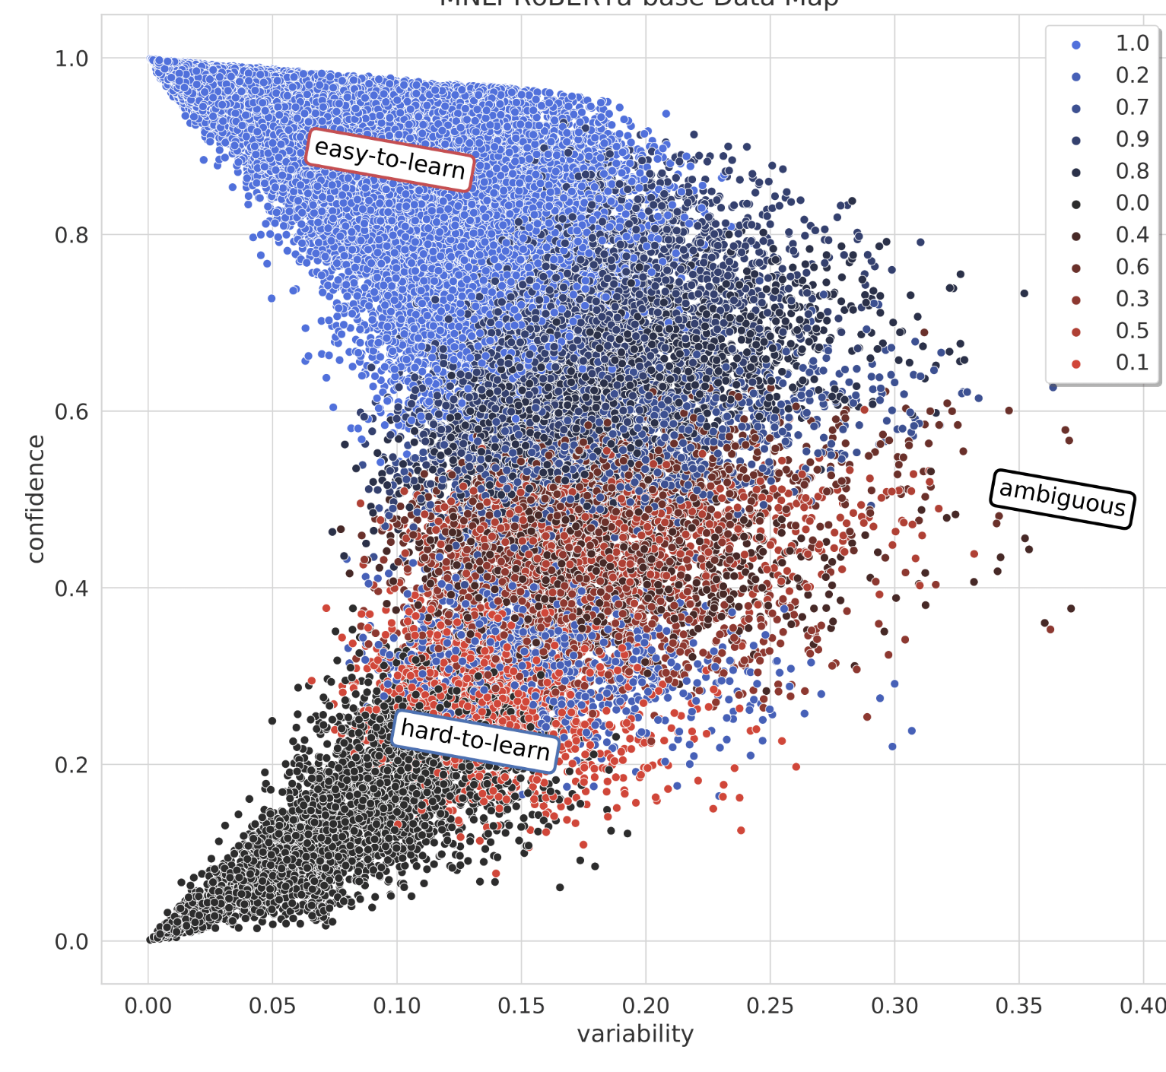
Data Map: effect of adapter on roberta-base
roberta base
roberta base with adapter
Notes:
The graph with adapter has more density towards right side of the x axis which indicates higher overall variability of the instances

Slide 12
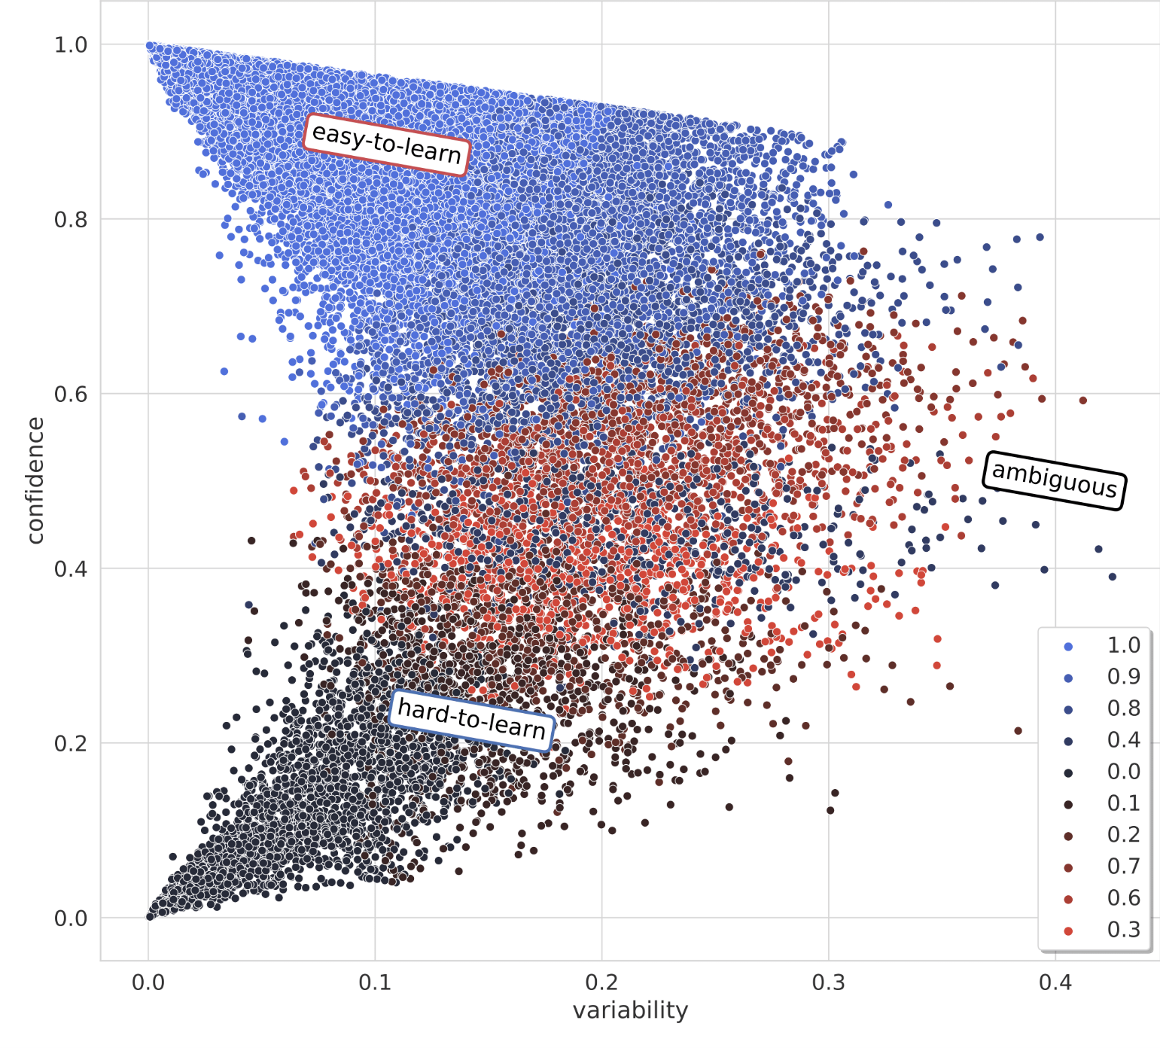
Data Map: effect of adapter on roberta-large
roberta large
roberta large with adapter
Notes:
Like the previous case we observe more variability when adapters are added. Moreover the points are concentrated towards top of y axis without adapters, indicating that adding adapters reduces overall confidence.

Slide 13
Observations
Higher parameters → lower overall variability, higher overall confidence
Introduction of adapters increases overall variability and reduces confidence
All model variants show most agreement on easy-to-learn examples and least agreement on hard-to-learn examples
Changes in data map are significant across models, but least significant when introducing adapters to a large model

Slide 14
Future Work
Further experiments:
Experimenting on QNLI, SNLI and other GLUE tasks
Investigating effect of parameter count:
Experimenting with more adapter configurations
Experimenting with model distillation
Investigating effect of adapters:
Exploring multi-task learning using adapter-fusion
Exploring cross-lingual transfer with language adapters

Slide 15


Slide 16
Proofs
Result 1: If we have two sequences x, y, let x denotes true values and y denotes predictions. Let 𝓟, 𝓡 denote the precision and recall respectively
Then: 𝓟(x,y) = 𝓡(y,x) and 𝓡(x,y) = 𝓟(y,x)
Proof:
We know 𝓟(x,y) = TP/(TP+FP), 𝓡(x,y) = TP/(TP+FN)
x: 1 1 0 0 after exchanging, y: 0 1 1 0 y: 0 1 1 0 x: 1 1 0 0
FN TP FP TN FP’ TP’ FN’ TN’
As we can see TP = TP’ , TN = TN’ while FN = FP’ and FN’ = FP (False +ve and False -ve swap)
𝓟(x,y) = TP/(TP+FP), 𝓟(y,x) = TP’/(TP’+FP’) = TP/(TP+FN) = 𝓡(x,y) (Similarly for the other case)

Slide 17
Proofs
Let’s say we binarize the partitions induced by each model using a target class C s.t.
1 → if model categorizes instance as belonging to C
0 → otherwise
In our case the class distribution between 1s and 0s is 1:2. (because there are 3 classes of size N/3, N/3, N/3,)
Let’s say the dataset has N instances.
∴ FN+TN = 2N/3 and TP+FP = N/3 also, FN+TP = N/3 and FP+TN = 2N/3
So we get FP = FN Since, 𝓟 = TP/(TP+FP) and 𝓡 = TP/(TP+FN), 𝓟 = 𝓡 for all our experiments

